Slide 1

Deep Learning For Terrain Prediction
This project proposes an automated system using CNN-based models to accurately classify and predict terrain from satellite or aerial imagery.
By: Himanshu Singh (2200290120083)
Krishna Kant Gupta (2200290120090)
Sanidhya Singh (2200290120148)
Project Guide: Prof. Vivek Kumar Sharma
Department: Computer Science

Slide 2
Project Abstract
Overview
Key Objectives
Approach
Terrain prediction is crucial for autonomous navigation, military operations, environmental monitoring, and disaster management. Current methods for terrain prediction are labor-intensive and error-prone, making them unsuitable for large-scale or real-time use.
The primary objective of this project is to develop a terrain prediction system using Convolutional Neural Networks (CNN).
The proposed solution uses CNNs for terrain prediction and classification from remote sensing data, such as multispectral or hyperspectral images. CNNs are ideal for this task because they automatically extract hierarchical spatial features from raw images. This makes them highly effective for complex terrain classification.

Slide 3

Project Goals and Objectives
Classification of images
1
Classify different terrain types (e.g., mountains, forests, rivers, deserts) based on satellite or aerial images.
2
Predictions from images
Achieve high accuracy and robustness in the predictions across varying image resolutions and conditions.
Provide scalable solution
3
Provide a scalable solution that can be applied to real-time applications like autonomous vehicle navigation and disaster management.

Slide 4

Alignment with UN Sustainable Development Goals (SDGs)
SDG 9: Industry, Innovation, and Infrastructure
SDG 11: Sustainable Cities
and Communities
Accurate terrain prediction aids sustainable urban planning.
Innovative CNN-based terrain prediction for resilient infrastructure.
SDG 13: Climate Action
SDG 15: Life on Land
Automated terrain analysis aids climate adaptation strategies.
Detailed terrain analysis supports conservation and reforestation.

Slide 5




Methodology and Approach
Data Preprocessing:
Satellite images from sources like Landsat and Sentinel-2 will be cleaned, augmented, and normalized. Data will be labeled using terrain maps or manually through GIS tools.
CNN Architecture Design:
The model uses convolutional layers with ReLU activations to learn image features, and max-pooling for efficiency. A fully connected layer classifies the terrain using softmax for multi-class output.
Model Training and Optimization:
Categorical cross-entropy will measure the difference between predicted and true terrain classes. The Adam optimizer will adjust weights to minimize loss during training.

Slide 6
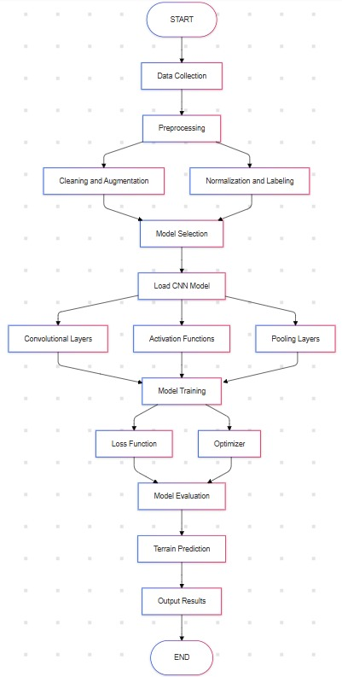
Flow chart

Slide 7
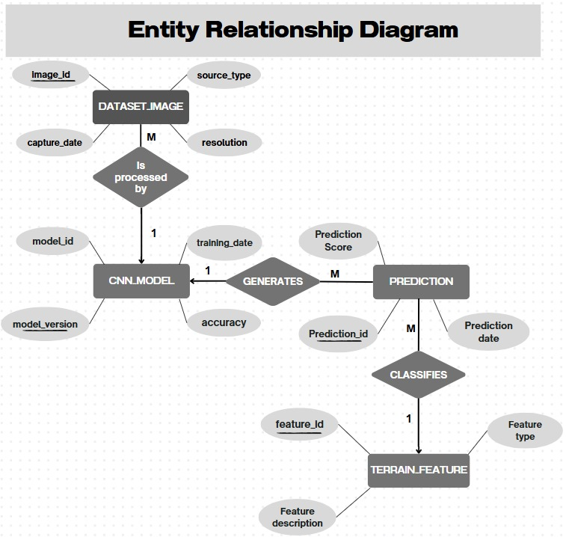
ER Diagram

Slide 8




Expected Outcomes and Impact
Enhanced Prediction Accuracy
Large-Scale Applications
Efficiency in Decision-Making
By utilizing CNN-based models, the system will be capable of providing high-precision terrain classification, reducing human error and improving the reliability of predictions.
The automated approach allows for efficient processing of vast amounts of satellite and aerial imagery, making it suitable for large-scale and real-time applications such as autonomous navigation and disaster response.
The automated terrain prediction system will facilitate faster and more informed decision-making processes, particularly in critical scenarios like emergency response and military operations.

Slide 9
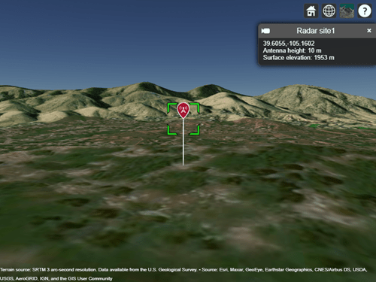
Key Project Deliverables
Data collection and preprocessing
Gathering satellite or aerial imagery for training and testing the CNN model.
Model design and training
Developing and fine-tuning a CNN model for terrain classification.
Evaluation and testing
Validating the model's accuracy, efficiency, and generalization to unseen data.
The project will consider use cases in autonomous vehicle navigation, military operations, and environmental monitoring.
Application areas

Slide 10

Next Steps and Conclusion
1
System Integration and Testing
2
Deployment and
Continuous Improvement
Integrate the trained model into a real-time prediction system and conduct extensive testing to validate performance across various environments.
Deploy the model for real-world applications and gather feedback for continuous enhancements, focusing on increasing prediction accuracy and system robustness.
3
Foundation for Future Research
This project lays the groundwork for future research in enhancing terrain classification accuracy and expanding its use in more complex and dynamic environments.

Slide 11
Git Hub Link:
https://github.com/him1308/Major-Project-Terrain-Prediction.git

